Slide 1
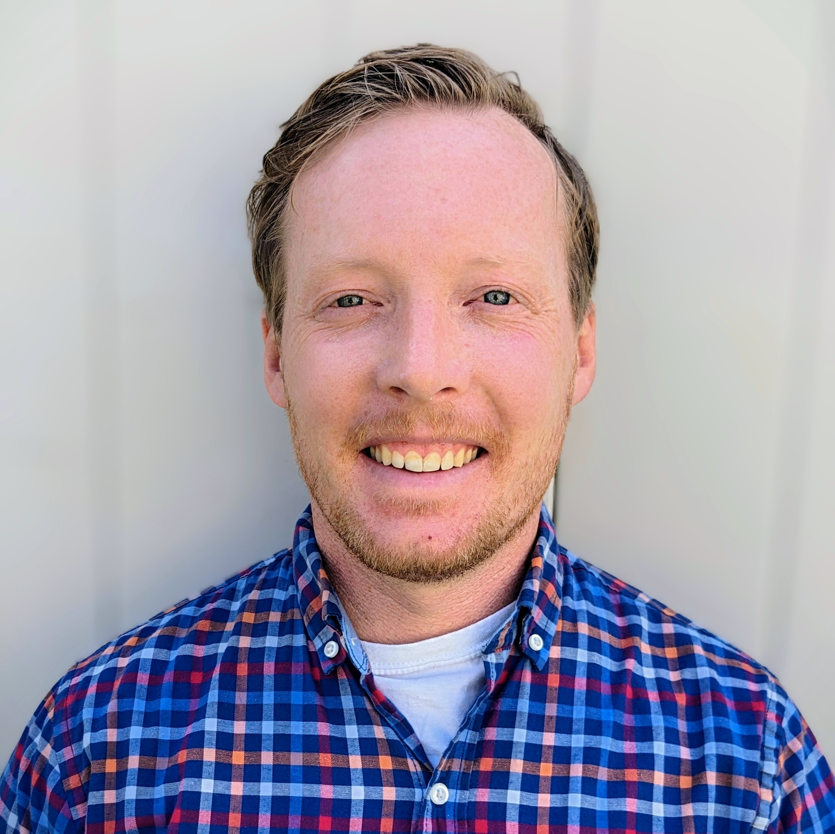
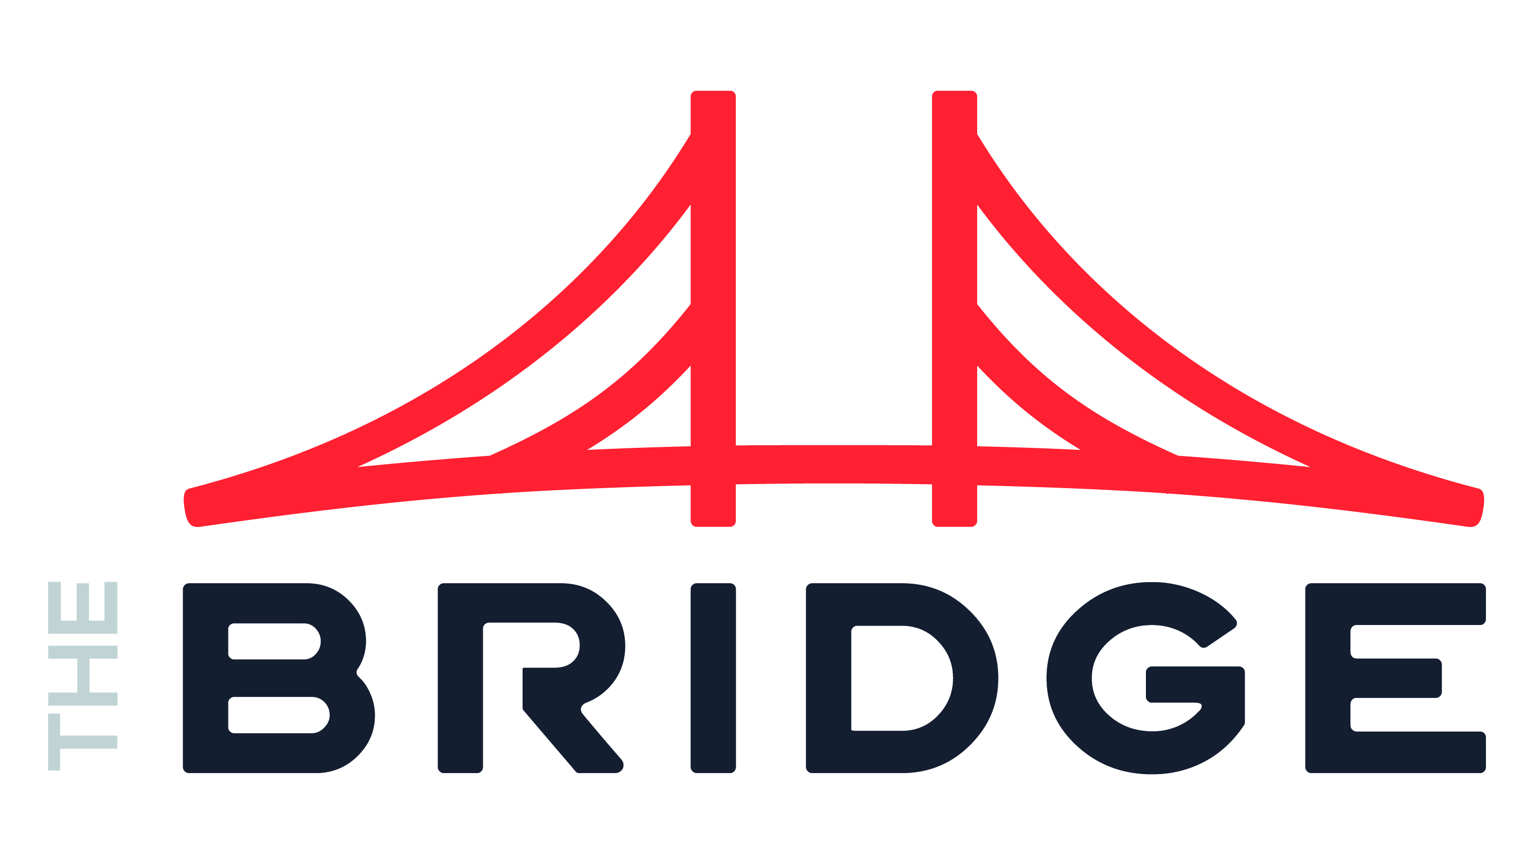
Patrick Murray Data Engineer
INDUSTRIES
Industry Experience
Construction Materials| Construction Engineering | Utilities Operation & Management |Nonprofit Management
EXPERIENCE
Modern Data Platform Creation| Construction Engineering​
Challenge: The client’s quote generation process was siloed and slow. It took days to get input from all stakeholders, and each department had their own prices for the same materials. There was a need for a data platform that unified the departments and mastered the materials and pricing among them.
Solution: Connected all silos of the business to enable one source of truth for all reporting within the company.​
Tools: Azure Cloud Services | Azure SQL | Azure Data Factory
Role: Constructed and managed the ETL workflows. Developed master data management workflow.
Data Warehousing and ETL consolidation | Construction Materials
Challenge: Client faced difficulties in managing its data architecture. ETL process was labor intensive, compounded by the need to integrate and disentangle data from newly acquired or divested companies. The creation of a platform by 25 contractors over 18 months led to technical debt, inconsistent implementations, complexities, tribal knowledge, missing requirements, difficult to maintain processes/solutions, and a spaghetti architecture. Additionally, when the contractors rolled off, all support and enhancement requests required heavy reverse engineering and re-interviewing stakeholders.
Solution: Created processes that simplified integrations and empowered stakeholders to communicate. Processes were cohesive and scalable, ensuring seamless integration and separation as required.
Tools: Azure SQL | Azure Data Factory | Azure Web Apps | Python
Role: Collaborated with business stakeholders, analyzed current practices, and designed frameworks to align with both current needs and future objectives.
BACKGROUND
Functional Skills
Data Governance | ETL Architecture | Data Visualizations | Web App Development | Leadership
Qualifications:
Consulting leader focused on Data Solutions. Patrick’s varied expertise ranges from technical machine operations to solutions architecture. Coupled with his excellent communication and interpersonal skills, Patrick can work through complex requirements to deliver what the business needs.
BIO & CONTACT INFO
After 10 years working in Utilities Operations, Patrick started his consulting career in 2022. He enjoys helping companies optimizing ETL processes and troubleshooting data governance problems. When he’s not in front of a computer, Patrick enjoys trail running, climbing, and backpacking in the Rockies.
Email
Patrick.Murray@thebridge.com
Mobile
(732) 570-4753
Location
Littleton, Colorado

